Slide 1
K-NN Classifier and Common issues in ML
Dr. Ratnakar Dash
Dept. of CSE
NIT Rourkela

Slide 2
Introduction
It is the easiest and simplest of supervised ML algorithms
Developed in 1951 by Fix & Hodges in 1951, and later expanded by Thomas Cover.
It is Non-Parametric and used for both Classification and Regression.
It classifies the data point on how its neighbor is classified.
Notes:
1911 Ramon-y-Cajal identifies the brain as a hierarchical network of nervous cells
A synaps consists of three parts:
Presynaptic terminal
Synaptic cleft
Postsynaptic membrane area
There are many distinct neurotransmitters
Depending on the particular mechanism
Either depolarization (excitation) or hyperpolarization (inhibition occurs)
Communication is directed
Dendrites collect inputs
Soma accumulates inputs
Triggering takes place at the axon hillock
Axon conducts signal (an axon can be very long up to 1 m)
Signal transmission along the axon is an electrical process and fast
120m/s (myelinated)
Transmission between nerons by chemical processes (neurotransmitters)
Plasticity (synapses may change in size and effectivity to transmit signalsveranderen)

Slide 3
Idea
Similar examples have similar label.
What is meant by Similar?
Similar means “close” and similar feature values.
Classify new examples like similar existing training examples.
Notes:
1911 Ramon-y-Cajal identifies the brain as a hierarchical network of nervous cells
A synaps consists of three parts:
Presynaptic terminal
Synaptic cleft
Postsynaptic membrane area
There are many distinct neurotransmitters
Depending on the particular mechanism
Either depolarization (excitation) or hyperpolarization (inhibition occurs)
Communication is directed
Dendrites collect inputs
Soma accumulates inputs
Triggering takes place at the axon hillock
Axon conducts signal (an axon can be very long up to 1 m)
Signal transmission along the axon is an electrical process and fast
120m/s (myelinated)
Transmission between nerons by chemical processes (neurotransmitters)
Plasticity (synapses may change in size and effectivity to transmit signalsveranderen)

Slide 4
Algorithm
Given new example x for which we need to predict its class y
Find most similar training examples (closest)
Classify x “like” these most similar examples
Notes:
1911 Ramon-y-Cajal identifies the brain as a hierarchical network of nervous cells
A synaps consists of three parts:
Presynaptic terminal
Synaptic cleft
Postsynaptic membrane area
There are many distinct neurotransmitters
Depending on the particular mechanism
Either depolarization (excitation) or hyperpolarization (inhibition occurs)
Communication is directed
Dendrites collect inputs
Soma accumulates inputs
Triggering takes place at the axon hillock
Axon conducts signal (an axon can be very long up to 1 m)
Signal transmission along the axon is an electrical process and fast
120m/s (myelinated)
Transmission between nerons by chemical processes (neurotransmitters)
Plasticity (synapses may change in size and effectivity to transmit signalsveranderen)

Slide 5
Questions:
How to determine similarity?
What are similarity measures to be used?
How does the KNN learn?
How many similar training examples to consider?
Notes:
1911 Ramon-y-Cajal identifies the brain as a hierarchical network of nervous cells
A synaps consists of three parts:
Presynaptic terminal
Synaptic cleft
Postsynaptic membrane area
There are many distinct neurotransmitters
Depending on the particular mechanism
Either depolarization (excitation) or hyperpolarization (inhibition occurs)
Communication is directed
Dendrites collect inputs
Soma accumulates inputs
Triggering takes place at the axon hillock
Axon conducts signal (an axon can be very long up to 1 m)
Signal transmission along the axon is an electrical process and fast
120m/s (myelinated)
Transmission between nerons by chemical processes (neurotransmitters)
Plasticity (synapses may change in size and effectivity to transmit signalsveranderen)

Slide 6
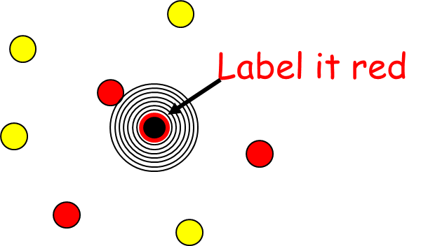
1-Nearest Neighbor
Does not use training points to construct a model
No parameters to be learned to create a model.
Training set is delayed to classification phase
Training set is used to compute the distance between the testing point and all points in training set
Notes:
1911 Ramon-y-Cajal identifies the brain as a hierarchical network of nervous cells
A synaps consists of three parts:
Presynaptic terminal
Synaptic cleft
Postsynaptic membrane area
There are many distinct neurotransmitters
Depending on the particular mechanism
Either depolarization (excitation) or hyperpolarization (inhibition occurs)
Communication is directed
Dendrites collect inputs
Soma accumulates inputs
Triggering takes place at the axon hillock
Axon conducts signal (an axon can be very long up to 1 m)
Signal transmission along the axon is an electrical process and fast
120m/s (myelinated)
Transmission between nerons by chemical processes (neurotransmitters)
Plasticity (synapses may change in size and effectivity to transmit signalsveranderen)

Slide 7
Basic Steps
Prepare data (split to training/testing)
Get first test data point
Calculate distance
Find closest neighbors
Vote for labels (majority rule)
Notes:
1911 Ramon-y-Cajal identifies the brain as a hierarchical network of nervous cells
A synaps consists of three parts:
Presynaptic terminal
Synaptic cleft
Postsynaptic membrane area
There are many distinct neurotransmitters
Depending on the particular mechanism
Either depolarization (excitation) or hyperpolarization (inhibition occurs)
Communication is directed
Dendrites collect inputs
Soma accumulates inputs
Triggering takes place at the axon hillock
Axon conducts signal (an axon can be very long up to 1 m)
Signal transmission along the axon is an electrical process and fast
120m/s (myelinated)
Transmission between nerons by chemical processes (neurotransmitters)
Plasticity (synapses may change in size and effectivity to transmit signalsveranderen)

Slide 8
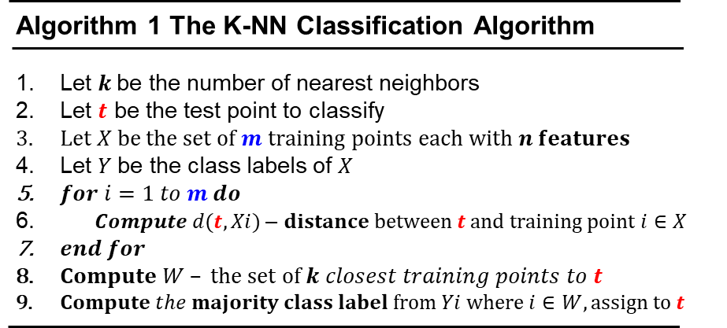
Algorithm
Notes:
1911 Ramon-y-Cajal identifies the brain as a hierarchical network of nervous cells
A synaps consists of three parts:
Presynaptic terminal
Synaptic cleft
Postsynaptic membrane area
There are many distinct neurotransmitters
Depending on the particular mechanism
Either depolarization (excitation) or hyperpolarization (inhibition occurs)
Communication is directed
Dendrites collect inputs
Soma accumulates inputs
Triggering takes place at the axon hillock
Axon conducts signal (an axon can be very long up to 1 m)
Signal transmission along the axon is an electrical process and fast
120m/s (myelinated)
Transmission between nerons by chemical processes (neurotransmitters)
Plasticity (synapses may change in size and effectivity to transmit signalsveranderen)

Slide 9
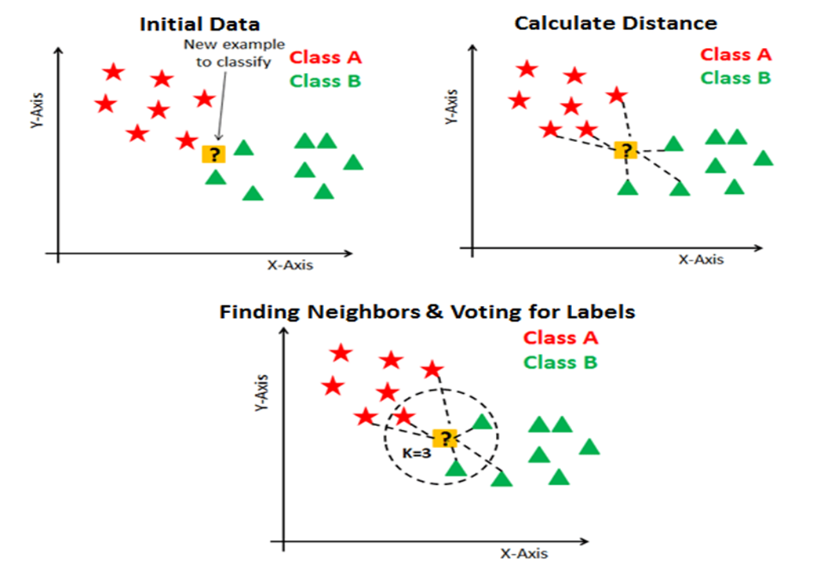
Algorithm
Notes:
1911 Ramon-y-Cajal identifies the brain as a hierarchical network of nervous cells
A synaps consists of three parts:
Presynaptic terminal
Synaptic cleft
Postsynaptic membrane area
There are many distinct neurotransmitters
Depending on the particular mechanism
Either depolarization (excitation) or hyperpolarization (inhibition occurs)
Communication is directed
Dendrites collect inputs
Soma accumulates inputs
Triggering takes place at the axon hillock
Axon conducts signal (an axon can be very long up to 1 m)
Signal transmission along the axon is an electrical process and fast
120m/s (myelinated)
Transmission between nerons by chemical processes (neurotransmitters)
Plasticity (synapses may change in size and effectivity to transmit signalsveranderen)

Slide 10
Class A
Class B
Belongs to Class B
Belongs to Class A
X1.1
K=3
K=6
X1.2

Slide 11
Complexity
Suppose there are m instances and n features in the dataset
Nearest neighbor algorithm requires computing m distances
Each distance computation involves scanning through each feature value (n features)
Running time complexity is O(m.n)
Notes:
1911 Ramon-y-Cajal identifies the brain as a hierarchical network of nervous cells
A synaps consists of three parts:
Presynaptic terminal
Synaptic cleft
Postsynaptic membrane area
There are many distinct neurotransmitters
Depending on the particular mechanism
Either depolarization (excitation) or hyperpolarization (inhibition occurs)
Communication is directed
Dendrites collect inputs
Soma accumulates inputs
Triggering takes place at the axon hillock
Axon conducts signal (an axon can be very long up to 1 m)
Signal transmission along the axon is an electrical process and fast
120m/s (myelinated)
Transmission between nerons by chemical processes (neurotransmitters)
Plasticity (synapses may change in size and effectivity to transmit signalsveranderen)

Slide 12
Choice of K
KNN Algorithm is based on feature similarity: Choosing the right value of K is a process called parameter tuning and is important for better accuracy.
K=7
K=3
?
New variable
At k = 3, we classify’?’ as
But at k = 7, we classify’?’ as
12
Notes:
We need to use Cross-validation to find a suitable value for k.

Slide 13
Selecting the Number of Neighbors
Increase k:
Makes KNN less sensitive to noise
Decrease k:
Allows capturing finer structure of space
Pick k not too large, but not too small (depends on data)
When we increase K, the training error will increase (increase bias), but the test error may decrease at the same time (decrease variance).
The bias will be 0 (but variance will be high) when K is small (K=1)
13
Notes:
K is a hyperparameter that is important to the KNN algorithm performance
The bias will be 0 when K=1,
However, when it comes to new data (in test set), it has higher chance to be an error, which causes high variance.
When we increase K, the training error will increase (increase bias), but the test error may decrease at the same time (decrease variance).

Slide 14
Selecting the Number of Neighbors
The numbers of nearest neighbors (K) should be based on cross validation over a number of K setting.
When K=1 is a good baseline model to benchmark against.
A good rule-of-thumb is: k should be less than the square root of the total number of training patterns.
Choose an odd “K” value for a Binary Classification problem.
“K” must not be a multiple of the number of classes for a Multi-class Classification problem.
14
Notes:
K is a hyperparameter that is important to the KNN algorithm performance
The bias will be 0 when K=1,
However, when it comes to new data (in test set), it has higher chance to be an error, which causes high variance.
When we increase K, the training error will increase (increase bias), but the test error may decrease at the same time (decrease variance).

Slide 15

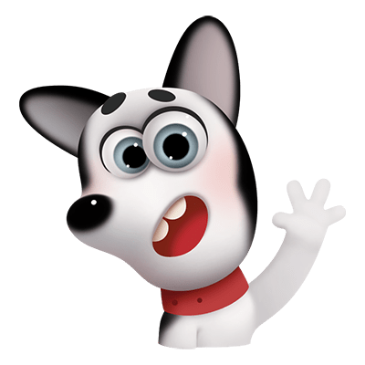
When to use KNN?
When data is labeled.
When data is noise free
When dataset is small (since KNN is a lazy learner i.e., doesn’t learn a discriminative function from the training set.)
weight | height | class
51 | 167 | underweight
62 | 182 | 23
65 | 172 | normal
Does our data have to be scaled? Why?
Since this algorithm relies on distance for classification, if the features represent different physical units or come in vastly different scales then normalizing the training data can improve its accuracy dramatically.
15
Notes:
Our data has to be labeled, noise free, small and also scaled why?
Distance based classifiers as we have covered in this course are sensitive to scaling and therefore our data has to be standardized.
Since this algorithm relies on distance for classification, if the features represent different physical units or come in vastly different scales then normalizing the training data can improve its accuracy dramatically.

Slide 16
When to use KNN?
Imbalanced datasets is an issue for most if not all Machine Learning Models.
On average KNN is considered to be a better performing algorithm compared to other traditional classifiers on imbalanced datasets.
The KNN does not require any “Training Time”, therefore if you do not wish to waste any time training a Machine Learning Model then the KNN would be a preferable algorithm.
The KNN does not need intensive Hyper-parameter tuning .. Therefore if the user does not wish to spend too much time on parameter tuning the KNN would be an ideal algorithm.
Compared to other simplistic classification algorithms such as Logistic Regression, the KNN on average performs better.
KNN can learn non-linear decision boundaries when used for classification and regression.
16
Notes:
In principal, unbalanced classes are not a problem at all for the k-nearest neighbor algorithm. Why?
Because the algorithm is not influenced in any way by the size of the class, it will not favor any on the basis of size.
Try to run k-means with an obvious outlier and k+1 and you will see that most of the time the outlier will get its own class.
The most important parameter that needs to be tuned is the value “K” ..
Other parameters may include the metric = ‘Euclidean’ or ‘Manhattan’ or other measure

Slide 17
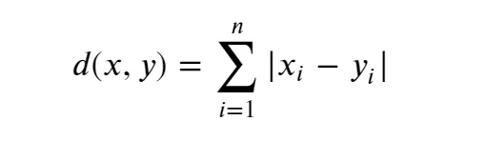
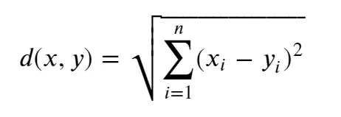
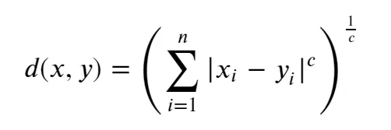
Distance Measures
Commonly used distance measures are
Manhattan distance
Euclidean distance
Minkowski distance
Notes:
1911 Ramon-y-Cajal identifies the brain as a hierarchical network of nervous cells
A synaps consists of three parts:
Presynaptic terminal
Synaptic cleft
Postsynaptic membrane area
There are many distinct neurotransmitters
Depending on the particular mechanism
Either depolarization (excitation) or hyperpolarization (inhibition occurs)
Communication is directed
Dendrites collect inputs
Soma accumulates inputs
Triggering takes place at the axon hillock
Axon conducts signal (an axon can be very long up to 1 m)
Signal transmission along the axon is an electrical process and fast
120m/s (myelinated)
Transmission between nerons by chemical processes (neurotransmitters)
Plasticity (synapses may change in size and effectivity to transmit signalsveranderen)

Slide 18
Distance Metric Properties
From the mathematical point of view, any set X (whose elements are called points) is said to be a metric space (Rudin 1976) if for any two points a, b ∈ X there is an associated real number d(a, b) called distance if the following properties hold true:
1. d(a, b) ≥ 0, (non-negativity)
2. d(a, b) = 0 ⇔ a = b (definiteness)
3. d(a, b) = d(b, a) (symmetry)
4. d(a, c) ≤ d(a, b) + d(b, c), for any b ∈ X (triangle inequality)
Any function with these properties is called a distance function, a distance measure, or a metric.
Notes:
1911 Ramon-y-Cajal identifies the brain as a hierarchical network of nervous cells
A synaps consists of three parts:
Presynaptic terminal
Synaptic cleft
Postsynaptic membrane area
There are many distinct neurotransmitters
Depending on the particular mechanism
Either depolarization (excitation) or hyperpolarization (inhibition occurs)
Communication is directed
Dendrites collect inputs
Soma accumulates inputs
Triggering takes place at the axon hillock
Axon conducts signal (an axon can be very long up to 1 m)
Signal transmission along the axon is an electrical process and fast
120m/s (myelinated)
Transmission between nerons by chemical processes (neurotransmitters)
Plasticity (synapses may change in size and effectivity to transmit signalsveranderen)

Slide 19
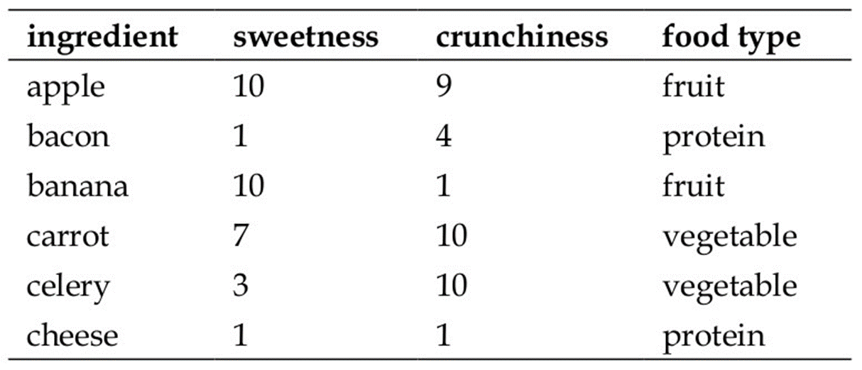
Example
Reference: Machine Learning with R, Brett Lantz, Packt Publishing
https://mitu.co.in/wp-content/uploads/2022/01/26.-K-Nearest-Neighbor.pdf
Notes:
1911 Ramon-y-Cajal identifies the brain as a hierarchical network of nervous cells
A synaps consists of three parts:
Presynaptic terminal
Synaptic cleft
Postsynaptic membrane area
There are many distinct neurotransmitters
Depending on the particular mechanism
Either depolarization (excitation) or hyperpolarization (inhibition occurs)
Communication is directed
Dendrites collect inputs
Soma accumulates inputs
Triggering takes place at the axon hillock
Axon conducts signal (an axon can be very long up to 1 m)
Signal transmission along the axon is an electrical process and fast
120m/s (myelinated)
Transmission between nerons by chemical processes (neurotransmitters)
Plasticity (synapses may change in size and effectivity to transmit signalsveranderen)

Slide 20
Example

Slide 21
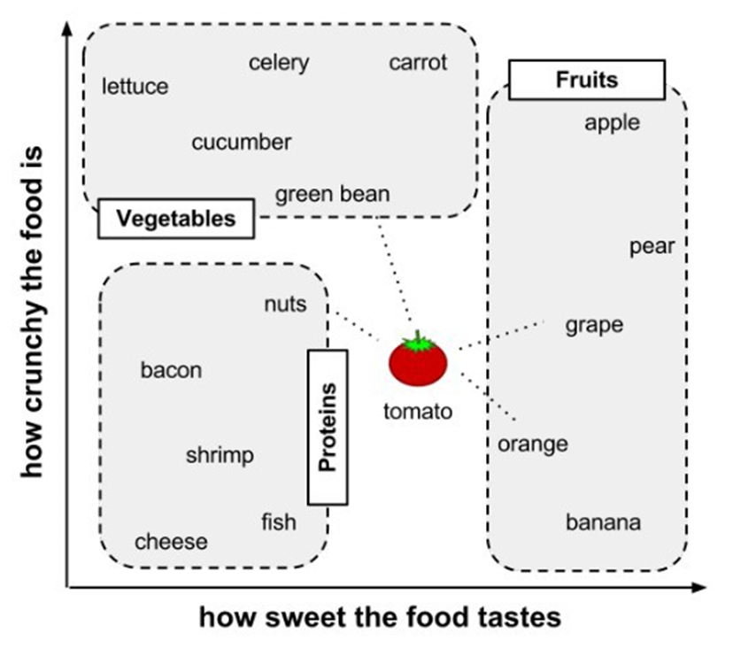
Example

Slide 22
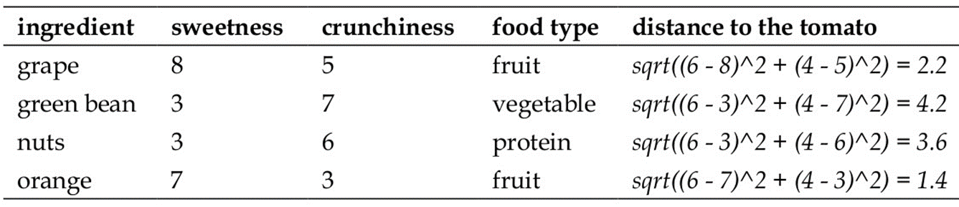
Example

Slide 23
Advantages and Limitations
Advantage:
Nonparametric architecture
Simple method and easy to understand
Powerful … performs quite well on many datasets
Requires no training time
Requires little tuning.
Disadvantage:
Memory intensive
Classification/estimation is slow
Prediction accuracy can quickly degrade when number of attributes grows.

Slide 24
Bias-Variance Dilemma, Overfitting and Underfitting
Bias:
refers to the error due to overly simplistic assumptions in the learning algorithm. These assumptions make the model easier to comprehend and learn but might not capture the underlying complexities of the data.
It is the error due to the model’s inability to represent the true relationship between input and output accurately. When a model has poor performance both on the training and testing data means high bias because of the simple model, indicating underfitting.
Variance:
is the error due to the model’s sensitivity to fluctuations in the training data. It’s the variability of the model’s predictions for different instances of training data.
High variance occurs when a model learns the training data’s noise and random fluctuations rather than the underlying pattern. As a result, the model performs well on the training data but poorly on the testing data, indicating overfitting.
24
Notes:
In principal, unbalanced classes are not a problem at all for the k-nearest neighbor algorithm. Why?
Because the algorithm is not influenced in any way by the size of the class, it will not favor any on the basis of size.
Try to run k-means with an obvious outlier and k+1 and you will see that most of the time the outlier will get its own class.
The most important parameter that needs to be tuned is the value “K” ..
Other parameters may include the metric = ‘Euclidean’ or ‘Manhattan’ or other measure

Slide 25
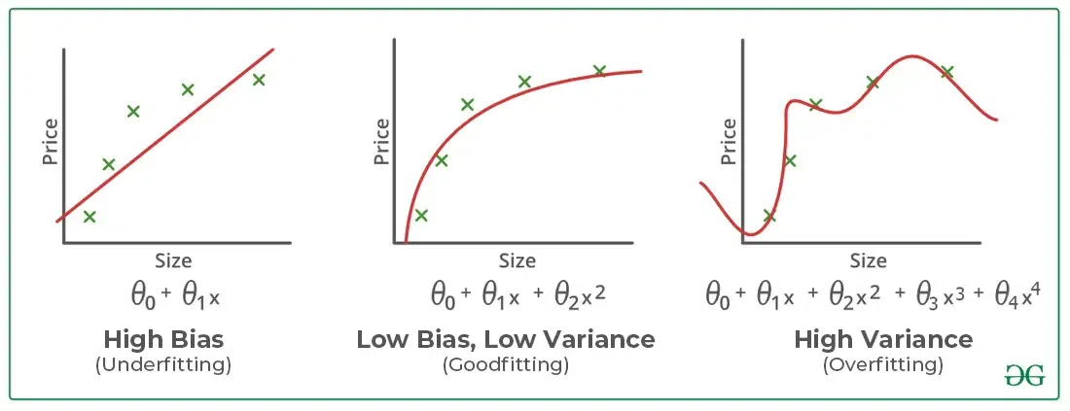
Bias-Variance Dilemma, Overfitting and Underfitting
Fig Ref: https://www.geeksforgeeks.org
25
Notes:
In principal, unbalanced classes are not a problem at all for the k-nearest neighbor algorithm. Why?
Because the algorithm is not influenced in any way by the size of the class, it will not favor any on the basis of size.
Try to run k-means with an obvious outlier and k+1 and you will see that most of the time the outlier will get its own class.
The most important parameter that needs to be tuned is the value “K” ..
Other parameters may include the metric = ‘Euclidean’ or ‘Manhattan’ or other measure

Slide 26
Preventing Overfitting and Underfitting
Techniques to Reduce Underfitting
Increase model complexity.
Increase the number of features, performing feature engineering.
Remove noise from the data.
Increase the number of epochs or increase the duration of training to get better results.
Techniques to Reduce Overfitting
Improving the quality of training data reduces overfitting by focusing on meaningful patterns, mitigate the risk of fitting the noise or irrelevant features.
Increase the training data can improve the model’s ability to generalize to unseen data and reduce the likelihood of overfitting.
Reduce model complexity.
Early stopping during the training phase (have an eye over the loss over the training period as soon as loss begins to increase stop training).
Ridge Regularization and Lasso Regularization.
Use dropout for neural networks to tackle overfitting.
26
Notes:
In principal, unbalanced classes are not a problem at all for the k-nearest neighbor algorithm. Why?
Because the algorithm is not influenced in any way by the size of the class, it will not favor any on the basis of size.
Try to run k-means with an obvious outlier and k+1 and you will see that most of the time the outlier will get its own class.
The most important parameter that needs to be tuned is the value “K” ..
Other parameters may include the metric = ‘Euclidean’ or ‘Manhattan’ or other measure

Slide 27
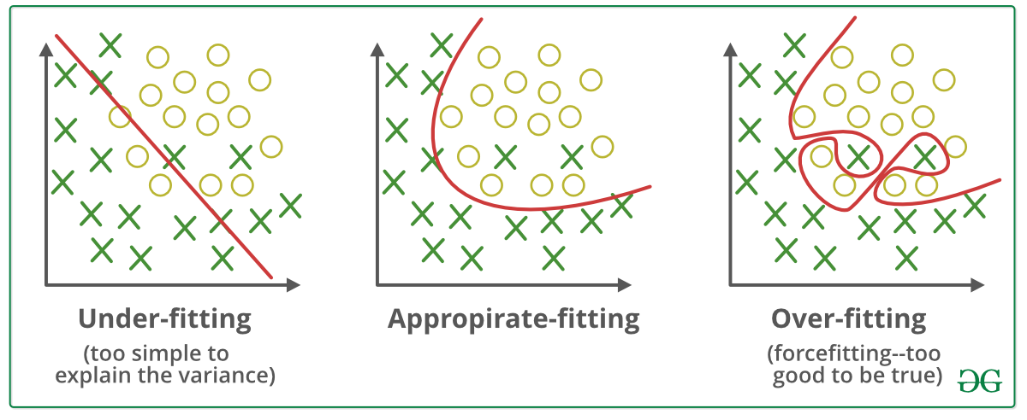
Overfitting and Underfitting
27
Notes:
In principal, unbalanced classes are not a problem at all for the k-nearest neighbor algorithm. Why?
Because the algorithm is not influenced in any way by the size of the class, it will not favor any on the basis of size.
Try to run k-means with an obvious outlier and k+1 and you will see that most of the time the outlier will get its own class.
The most important parameter that needs to be tuned is the value “K” ..
Other parameters may include the metric = ‘Euclidean’ or ‘Manhattan’ or other measure

Slide 28
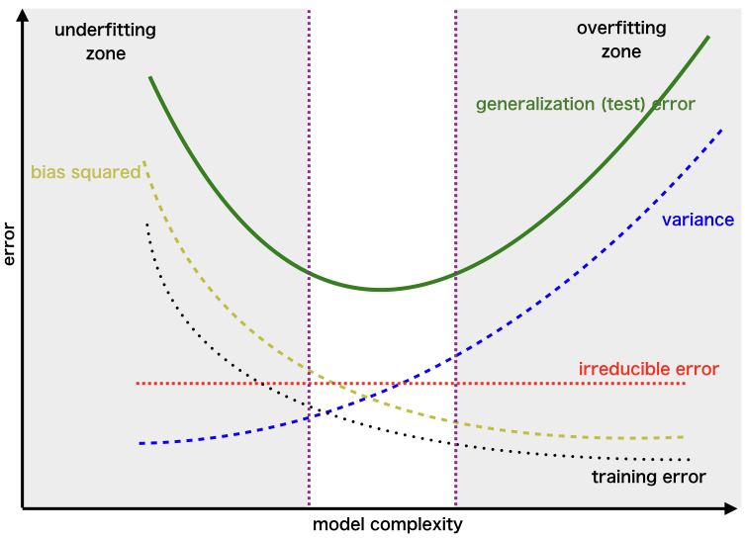
TRADE-OFF

Slide 29
Data Normalization and Standardization
Normalization is an essential step in the preprocessing of data for machine learning models, and it is a feature scaling technique. Normalization is especially crucial for data manipulation, scaling down, or up the range of data before it is utilized for subsequent stages.
The current data range is transformed into a new, standardized range using this method.
Data normalization improves the consistency and comparability of different predictive models by standardizing the range of independent variables or features within a dataset, leading to more steady and dependable results.
This usually entails rescaling the features to a standard range, which is typically between 0 and 1. Alternatively, the features can be adjusted to have a mean of 0 and a standard deviation of 1.
29
Notes:
In principal, unbalanced classes are not a problem at all for the k-nearest neighbor algorithm. Why?
Because the algorithm is not influenced in any way by the size of the class, it will not favor any on the basis of size.
Try to run k-means with an obvious outlier and k+1 and you will see that most of the time the outlier will get its own class.
The most important parameter that needs to be tuned is the value “K” ..
Other parameters may include the metric = ‘Euclidean’ or ‘Manhattan’ or other measure

Slide 30
Need of Data Normalization in ML
It guarantees that every feature contributes equally, preventing larger-magnitude features from others.
It enables faster convergence of algorithms for optimisation
Normalisation improves overall performance by addressing model sensitivity problems in SVM and NN.
normalisation is necessary when working with attributes that have different scales;
30
Notes:
In principal, unbalanced classes are not a problem at all for the k-nearest neighbor algorithm. Why?
Because the algorithm is not influenced in any way by the size of the class, it will not favor any on the basis of size.
Try to run k-means with an obvious outlier and k+1 and you will see that most of the time the outlier will get its own class.
The most important parameter that needs to be tuned is the value “K” ..
Other parameters may include the metric = ‘Euclidean’ or ‘Manhattan’ or other measure

Slide 31
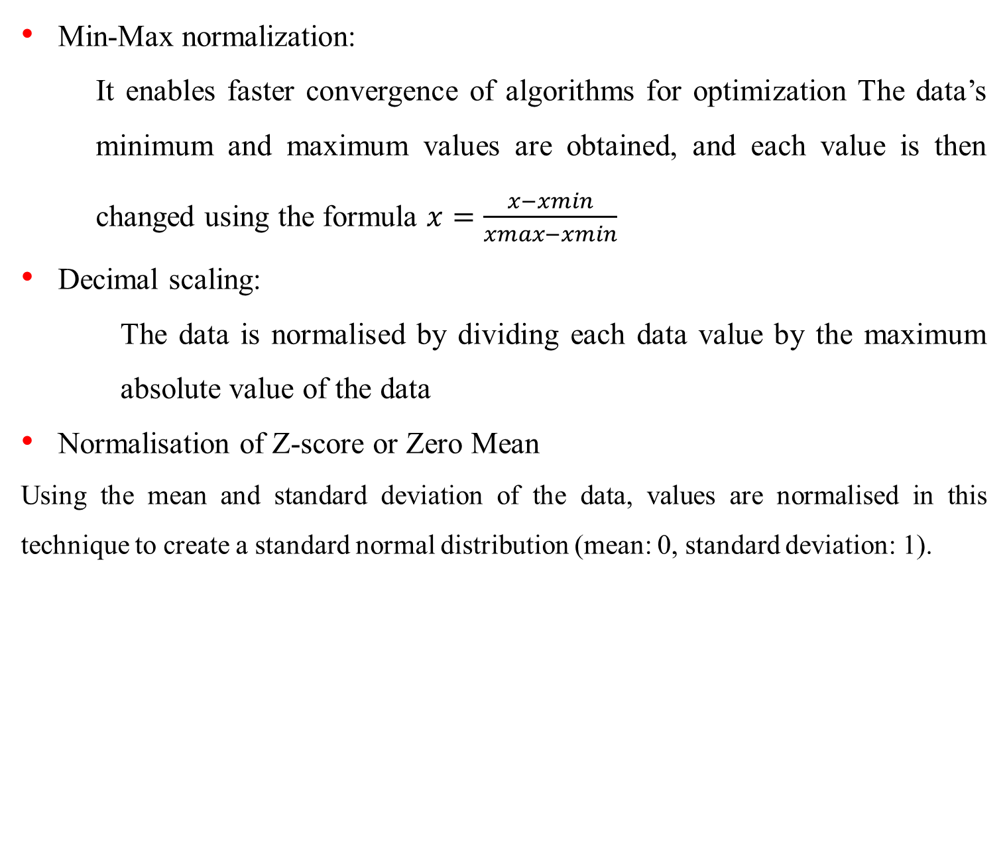
Data Normalization Techniques
Min-Max normalization:
It enables faster convergence of algorithms for optimization The data’s minimum and maximum values are obtained, and each value is then changed using the formula $x=\frac{x−xmin}{xmax−xmin}$
Decimal scaling:
The data is normalised by dividing each data value by the maximum absolute value of the data
Normalisation of Z-score or Zero Mean
Using the mean and standard deviation of the data, values are normalised in this technique to create a standard normal distribution (mean: 0, standard deviation: 1).
31
Notes:
In principal, unbalanced classes are not a problem at all for the k-nearest neighbor algorithm. Why?
Because the algorithm is not influenced in any way by the size of the class, it will not favor any on the basis of size.
Try to run k-means with an obvious outlier and k+1 and you will see that most of the time the outlier will get its own class.
The most important parameter that needs to be tuned is the value “K” ..
Other parameters may include the metric = ‘Euclidean’ or ‘Manhattan’ or other measure

Slide 32
Data Normalization Vs Data Standardisation
Normalization | Standardization
Normalization scales the values of a feature to a specific range, often between 0 and 1. | Standardization scales the features to have a mean of 0 and a standard deviation of 1.
Applicable when the feature distribution is uncertain. | Effective when the data distribution is Gaussian.
Susceptible to the influence of outliers | Less affected by the presence of outliers.
Maintains the shape of the original distribution | Alters the shape of the original distribution.
Scales values to ranges like [0, 1]. | Scale values are not constrained to a specific range.
32
Notes:
In principal, unbalanced classes are not a problem at all for the k-nearest neighbor algorithm. Why?
Because the algorithm is not influenced in any way by the size of the class, it will not favor any on the basis of size.
Try to run k-means with an obvious outlier and k+1 and you will see that most of the time the outlier will get its own class.
The most important parameter that needs to be tuned is the value “K” ..
Other parameters may include the metric = ‘Euclidean’ or ‘Manhattan’ or other measure

Slide 33
References
https://islab.soe.uoguelph.ca/sareibi/TEACHING_dr/ENG6600_ML_html_dr/outline_eng6600/docs/LECTURE_dr/TOPIC5c_dr/LECT_dr/ENG6500-5c-KNN.pptx
Machine Learning with R, Brett Lantz, Packt Publishing
https://mitu.co.in/wp-content/uploads/2022/01/26.-K-Nearest-Neighbor.pdf

Slide 34
Thank You
ratnakar@nitrkl.ac.in

